Slide 1
DATA607 - COVID Data
Josh Iden and Jawaid Hakim

Slide 2
Motivation
Use COVID-19 datasets to explore global pandemic stats
Explore relationships between COVID-19 prevalence and other datasets, e.g. mask policies, S&P500

Slide 3
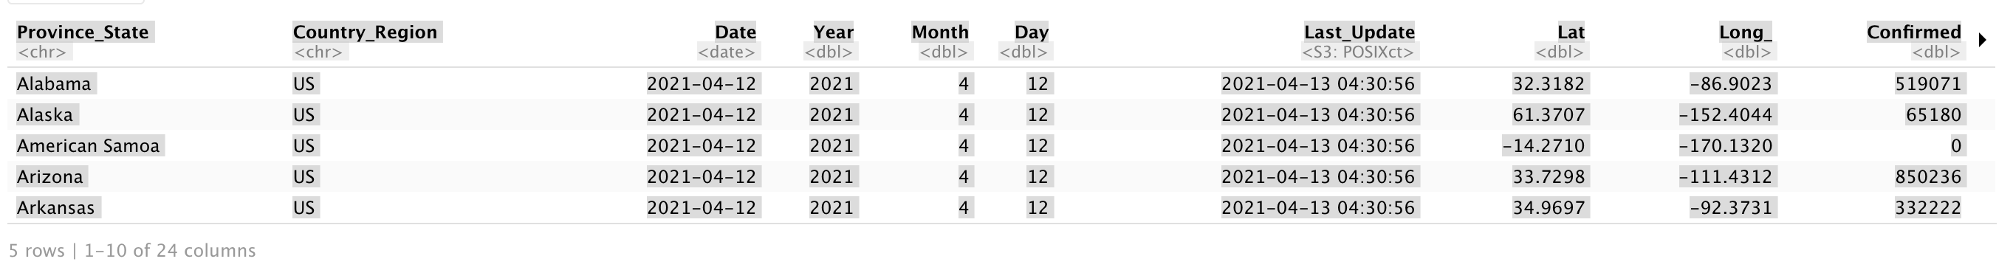
Data Acquisition - JHU CSSE USA Daily Data
US Daily

Slide 4
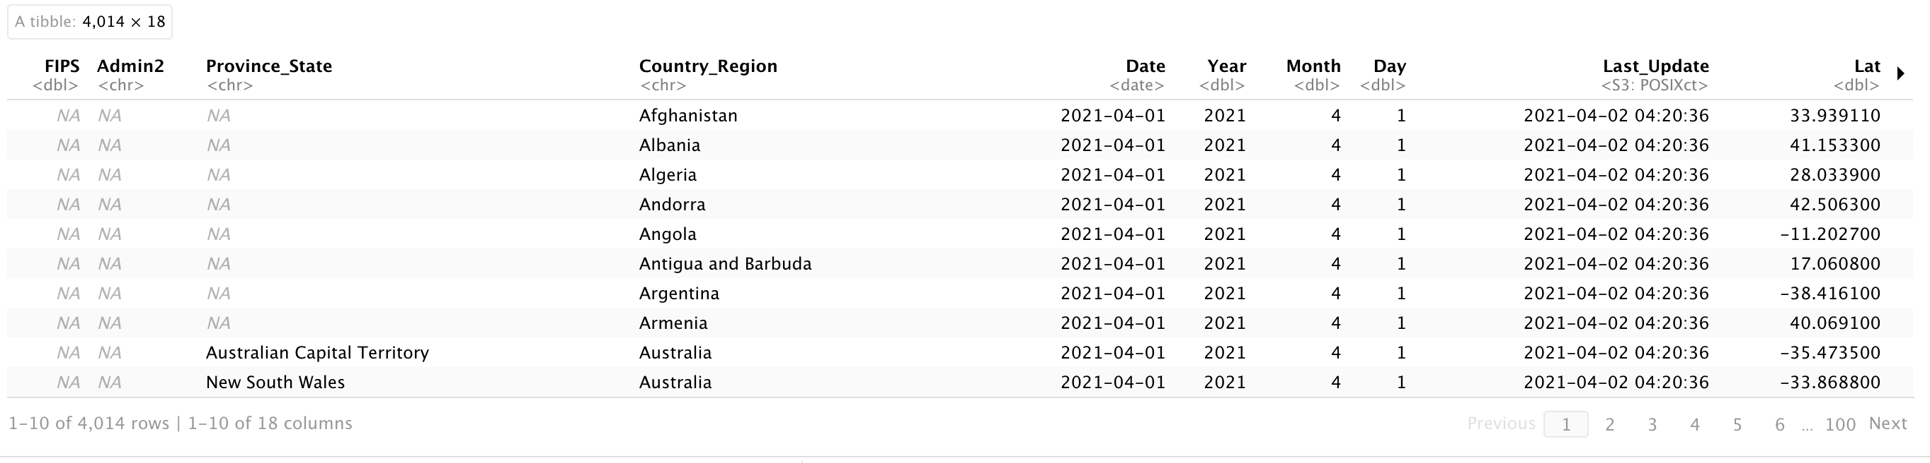
Data Acquisition - JHU CSSE Global timeseries
Global Timeseries

Slide 5
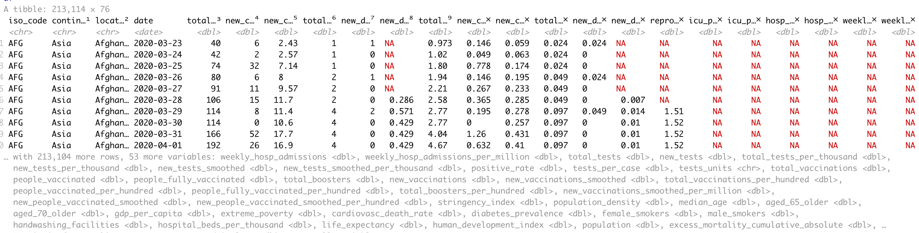
Data Acquisition - Our World In Data
OWID Timeseries

Slide 6
Data Wrangling - Parallel Processing
Common data extraction scripts/functions across datasets
Parallel processing
Table extraction (scraping) from HTML using Selenium/readr
Spark cluster interface

Slide 7
Data Wrangling - Hurdles
Github API rate limits. Implemented OAuth authentication to access Github via a personal account for higher limits.
OWID dataset did not provide latitude/longitude variables which would be handy for map plots. Downloaded a separate dataset with country lat/long and (left-)joined with OWID for plotting on

Slide 8
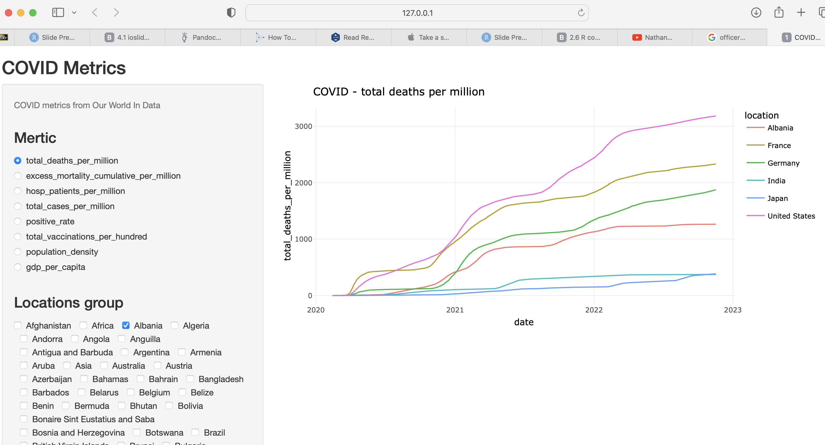
Data Exploration - Interactive exploration using Shiny
OWID Data Exploration

Slide 9
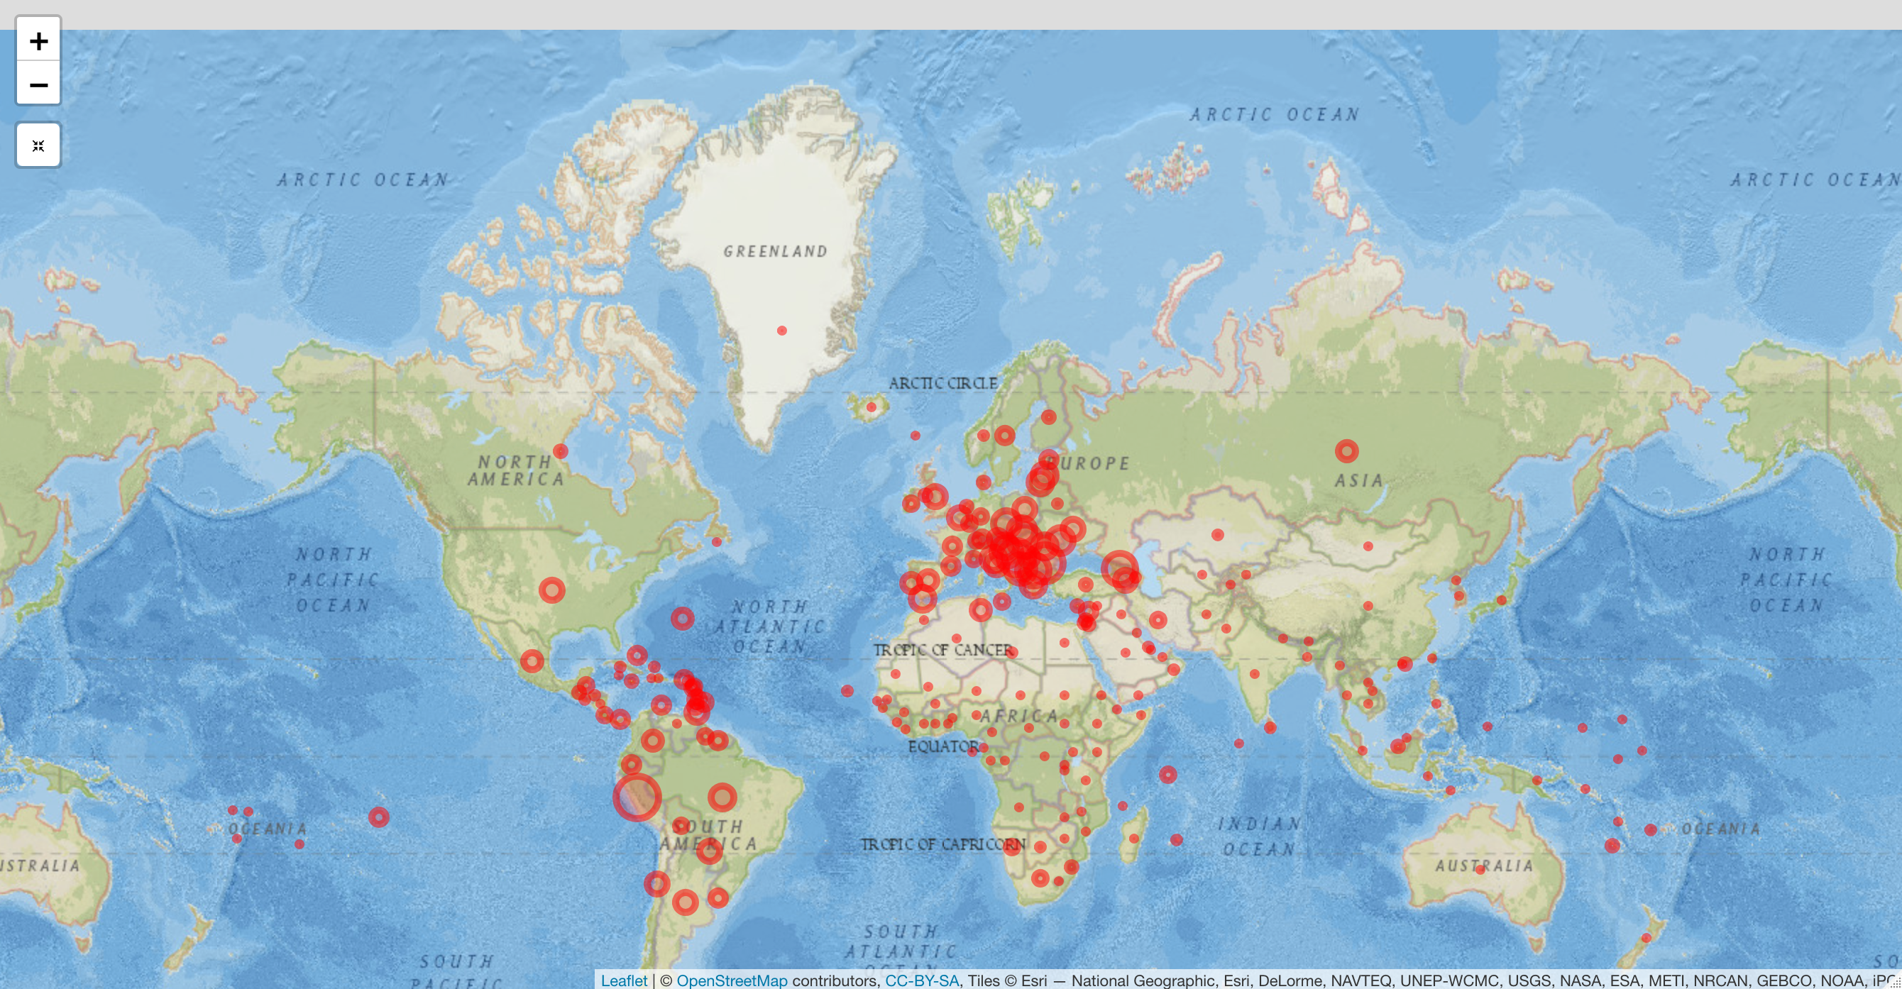
Data Exploration - Interactive gerographic exploration using Leaflet
OWID Data Exploration

Slide 10
Data Analytics - Spark

Slide 11
Tech Stack
Rselenium: headless browser capability to solve for embedded JavaScript
parallel: efficient processing of datsets using local cluster
readr: reading remote/local CSVs
leaflet: rendering interactive global map
Spark/sparklr: proof-of-concept for EDAs on large datasets. Cloud hosted Spark services are either fee-based or time-limited so used a local cluster
AWS S3: explored storagestoring datasets on AWS/S3. However, S3 storage rate-limits made this impractical (20,000 GET Requests; 2,000 PUT, COPY, POST, or LIST Requests each month)

